Slide 1
Authentication Technologies
HTML forms-based authentication
Multifactor mechanisms, such as those combining passwords and physical tokens
Client SSL certificates and/or smartcards
HTTP basic and digest authentication
Windows-integrated authentication using NTLM or Kerberos
Authentication services

Slide 2
Design Flaws in Authentication Mechanisms

Slide 3
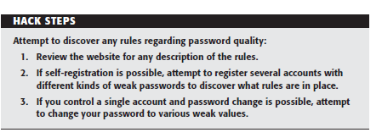
Bad Passwords

Slide 4
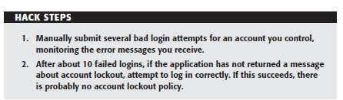
Brute-Forcible Login

Slide 5
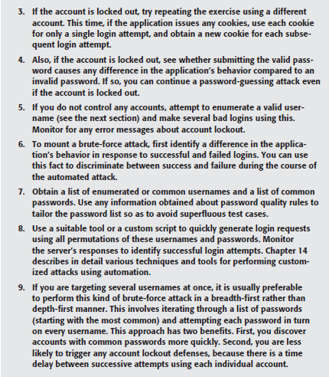

Slide 6
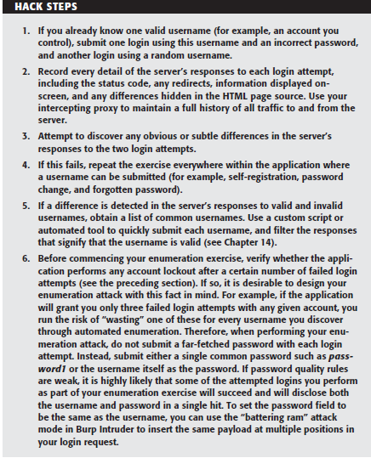
Verbose Failure Messages

Slide 7
Vulnerable Transmission of Credentials
On the user’s local network
Within the user’s IT department
Within the user’s ISP
On the Internet backbone
Within the ISP hosting the application
Within the IT department managing the application

Slide 8
Vulnerable Transmission of Credentials
Even if login occurs over HTTPS, credentials may still be disclosed to unauthorized parties if the application handles them in an unsafe manner:
If credentials are transmitted as query string parameters, as opposed to in the body of a POST request, these are liable to be logged in various places, such as within the user’s browser history, within the web server logs, and within the logs of any reverse proxies employed within the hosting infrastructure.

Slide 9
Vulnerable Transmission of Credentials
Although most web applications do use the body of a POST request to submit the HTML login form itself, it is surprisingly common to see the login request being handled via a redirect to a different URL with the same credentials passed as query string parameters
Web applications sometimes store user credentials in cookies, usually to implement poorly designed mechanisms for login, password change, “remember me,” and so on.

Slide 10
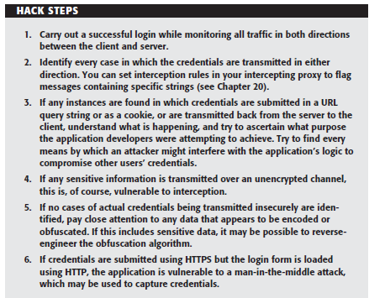

Slide 11
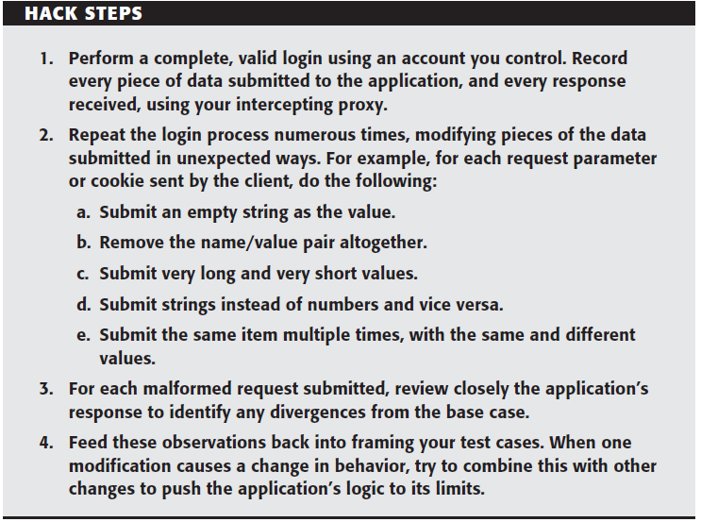
Implementation Flaws in Authentication
Fail-Open Login Mechanisms

Slide 12
Defects in Multistage Login Mechanisms
Problems
An application may assume that a user who accesses stage three must have cleared stages one and two.
An application may trust some of the data being processed at stage two because this was validated at stage one.
An application may assume that the same user identity is used to complete each stage; however, it might not explicitly check this.

Slide 13
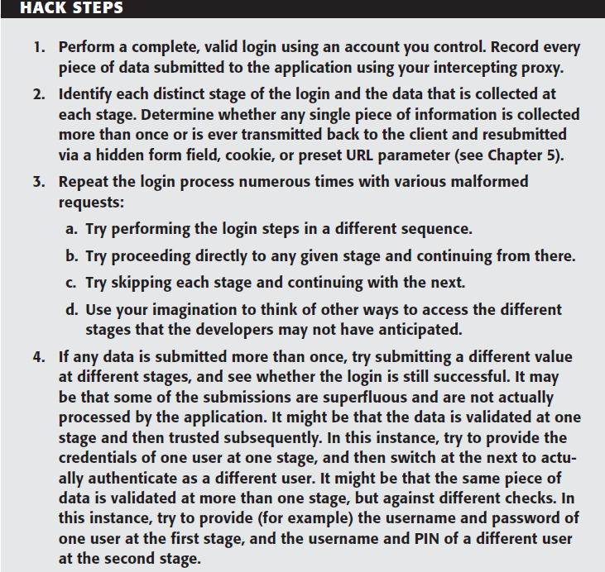

Slide 14
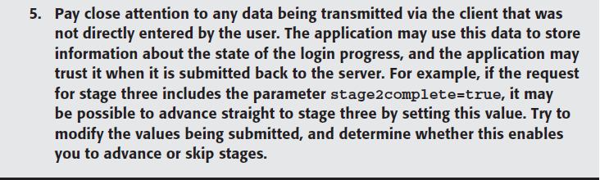

Slide 15
Improvement
Asking different question
Problem
The application may present a randomly chosen question and store the details within a hidden HTML form fi eld or cookie, rather than on the server.
The application may present a randomly chosen question on each login attempt but not remember which question a given user was asked if he or she fails to submit an answer.

Slide 16
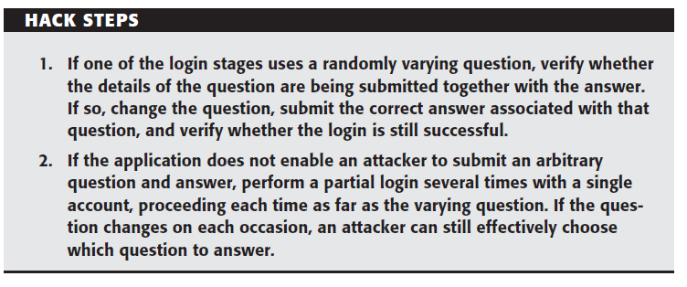

Slide 17
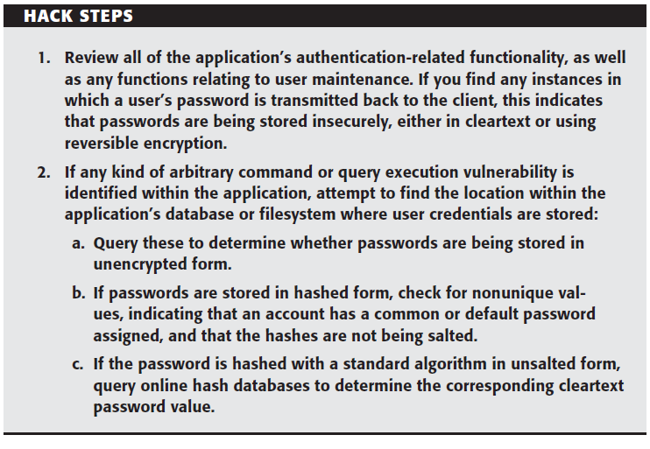
Insecure Storage of Credentials

Slide 18
Securing Authentication
Striking an appropriate balance:
The criticality of security given the functionality that the application offers. The degree to which users will tolerate and work with different types of authentication controls.
The cost of supporting a less user-friendly system.
The financial cost of competing alternatives in relation to the revenue likely to be generated by the application or the value of the assets it protects

Slide 19
Use Strong Credentials
Suitable minimum password quality requirements should be enforced.
Usernames should be unique.
Any system-generated usernames and passwords should be created with sufficient entropy that they cannot feasibly be sequenced or predicted even by an attacker who gains access to a large sample of successively generated instances.
Users should be permitted to set suffi ciently strong passwords

Slide 20
Handle Credentials Secretively
All credentials should be created, stored, and transmitted in a manner that does not lead to unauthorized disclosure.
All client-server communications should be protected using a well established cryptographic technology, such as SSL.
Switching to HTTPS
Only POST requests should be used to transmit credentials to the server.
strong hash function

Slide 21
Handle Credentials Secretively
Client-side “remember me” functionality should in general remember only non secret items such as usernames.
A password change facility should be implemented (see the “Prevent Misuse of the Password Change Function” section), and users should be required to change their password periodically.
Where credentials for new accounts are distributed to users out-of-band, these should be sent as securely as possible and should be time-limited.
Where applicable, consider capturing some of the user’s login information (for example, single letters from a memorable word) using drop-down menus rather than text fields.

Slide 22
Validate Credentials Properly
The application should be aggressive in defending itself against unexpected events occurring during login processing
Passwords should be validated in full.
All authentication logic should be closely code-reviewed
If functionality to support user impersonation is implemented, this should be strictly controlled to ensure that it cannot be misused to gain unauthorized access

Slide 23
Validate Credentials Properly
Multistage logins :
All data about progress through the stages and the results of previous validation tasks should be held in the server-side session object and should never be transmitted to or read from the client.
No items of information should be submitted more than once by the user, and there should be no means for the user to modify data that has already been collected and/or validated.

Slide 24
Validate Credentials Properly
Multistage logins :
The first task carried out at every stage should be to verify that all prior stages have been correctly completed.
To prevent information leakage about which stage of the login failed (which would enable an attacker to target each stage in turn), the application should always proceed through all stages of the login, even if the user failed to complete earlier stages correctly, and even if the original username was invalid.

Slide 25
Validate Credentials Properly
Where a login process includes a randomly varying question:
Always employ a multistage process in which users identify themselves at an initial stage and the randomly varying question is presented to them at a later stage
When a given user has been presented with a given varying question, store that question within her persistent user profile, and ensure that the same user is presented with the same question on each attempted login until she successfully answers it.

Slide 26
Validate Credentials Properly
When a randomly varying challenge is presented to the user, store the question that has been asked in a server-side session variable, rather than a hidden field in an HTML form, and validate the subsequent answer against that saved question.

Slide 27
Forgotten Password Functionality
Several kinds of design weaknesses can often be found:
Forgotten password functionality often involves presenting the user with a secondary challenge in place of the main login
As with password change functionality, application developers commonly overlook the possibility of brute-forcing the response to a password recovery challenge, even when they block this attack on the main login page.
In some applications, the recovery challenge is replaced with a simple password “hint” that is configured by users during registration

Slide 28
Forgotten Password Functionality
The mechanism by which an application enables users to regain control of their account after correctly responding to a challenge is often vulnerable.
Some applications disclose the existing, forgotten password to the user after successful completion of a challenge, enabling an attacker to use the account indefinitely without any risk of detection by the owner.
Some applications immediately drop the user into an authenticated session after successful completion of a challenge
Some applications employ the mechanism of sending a unique recovery URL but send this to an e-mail address specified by the user at the time the challenge is completed
Some applications allow users to reset their password’s value directly after successful completion of a challenge and do not send any e-mail notifi cation to the user.

Slide 29
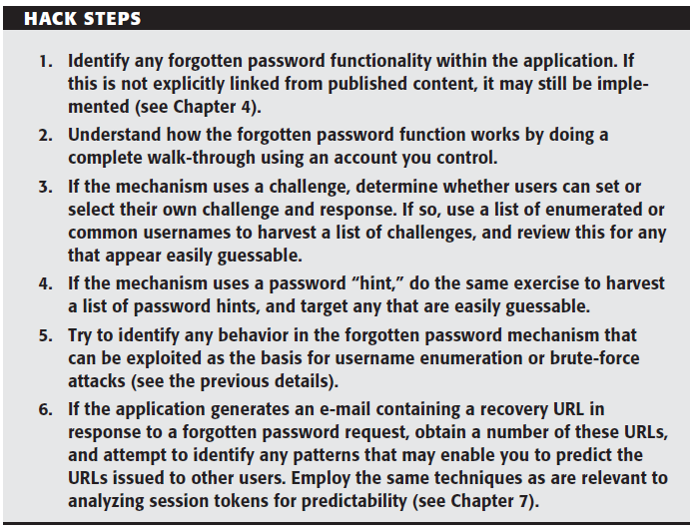

Slide 30
Remember Me Functionality
Some “remember me” functions are implemented using a simple persistent cookie
Some “remember me” functions set a cookie that contains not the username but a kind of persistent session identifier, such as RememberUser=1328.
Even if the information stored for reidentifying users is suitably protected (encrypted) to prevent other users from determining or guessing it, the information may still be vulnerable to capture through a bug such as cross-site scripting

Slide 31
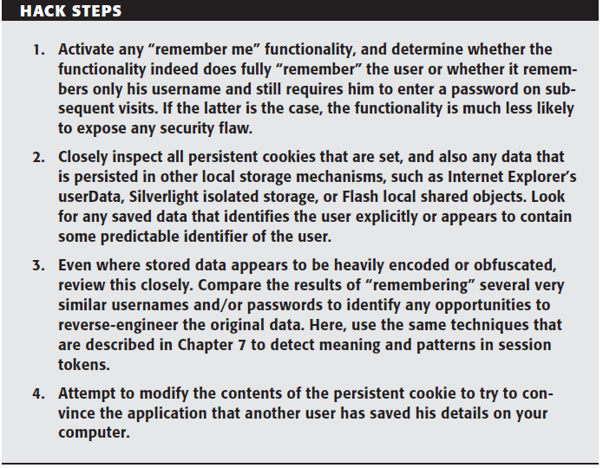

Slide 32
User Impersonation Functionality
It may be implemented as a “hidden” function, which is not subject to proper access controls. For example, anyone who knows or guesses the URL /admin/ImpersonateUser.jsp may be able to make use of the function and impersonate any other user.
The application may trust user-controllable data when determining whether the user is performing impersonation.
If an application allows administrative users to be impersonated, any weakness in the impersonation logic may result in a vertical privilege escalation vulnerability.
Some impersonation functionality is implemented as a simple “backdoor” password that can be submitted to the standard login page along with any username to authenticate as that user.

Slide 33
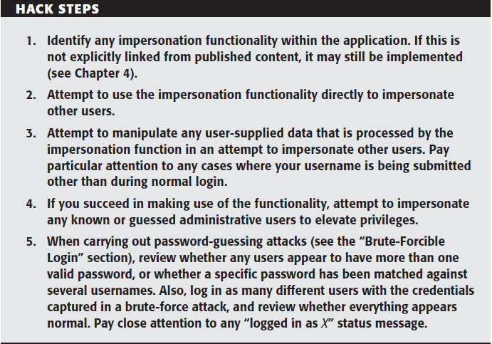

Slide 34
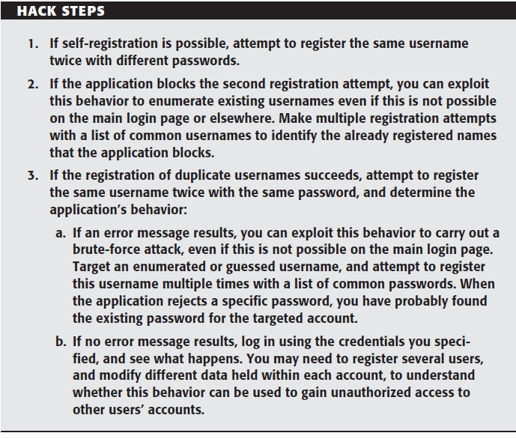
Nonunique Usernames

Slide 35
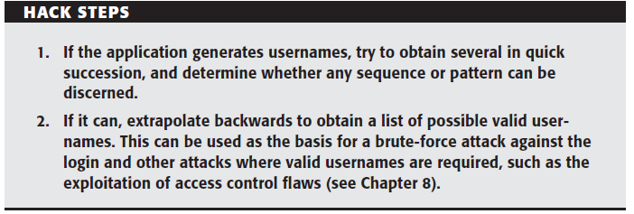
Predictable Usernames

Slide 36
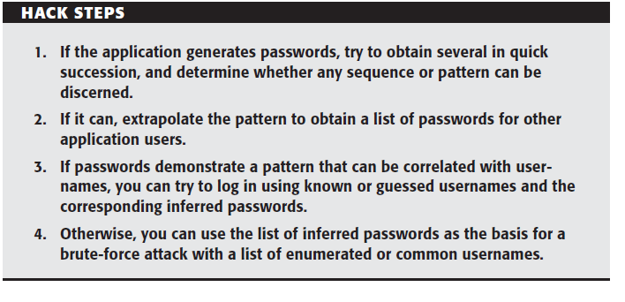
Predictable Initial Passwords

Slide 37
Prevent Information Leakage
The various authentication mechanisms used by the application should not disclose any information about authentication parameters, through either overt messages or inference from other aspects of the application’s behavior.
A single code component should be responsible for responding to all failed login attempts with a generic message
If the application enforces some kind of account lockout to prevent bruteforce, be careful not to let this lead to any information leakage.

Slide 38
Prevent Information Leakage
If the application supports self-registration
Instead of permitting self-selection of usernames
The application can use e-mail addresses as usernames.

Slide 39
Prevent Brute-Force Attacks
Measures need to be enforced within all the various challenges implemented by the authentication functionality to prevent attacks that attempt to meet those challenges using automation.
Using unpredictable usernames and preventing their enumeration presents a significant obstacle to completely blind brute-force attacks.
Lockout with out of band verification

Slide 40
Prevent Brute-Force Attacks
If a policy of temporary account suspension is implemented:
To prevent information leakage leading to username enumeration, the application should never indicate that any specific account has been suspended.
The policy’s metrics should not be disclosed to users
If an account is suspended, login attempts should be rejected without even checking the credentials.
Per-account countermeasures such as account lockout do not help protect against one kind of brute-force attack that is often highly effective — iterating through a long list of enumerated usernames, checking a single weak password, such as password.
Use of CAPTACH

Slide 41
Prevent Misuse of the Password Change Function
The function should be accessible only from within an authenticated session.
There should be no facility to provide a username, either explicitly or via a hidden form field or cookie.
security defect in the application — such as a session-hijacking vulnerability, cross-site scripting, or even an unattended terminal. To this end, users should be required to reenter their existing password.

Slide 42
Prevent Misuse of the Password Change Function
The new password should be entered twice to prevent mistakes.
Users should be notified out-of-band (such as via e-mail) that their password has been changed, but the message should not contain either their old or new credentials.

Slide 43
Prevent Misuse of the Account Recovery Function
Log, Monitor, and Notify

